Slide 1
4/29/2016
Notes:
I picked this paper because I hoped that everyone in the group can get something out of it. Please feel free to jump in as I’m bound to make mistakes in trying to piece together the how and the why.

Slide 2
Outline
Classes of iNs
Methods
Ribotaggin’
Linkage analysis
RNAi
Visual stim, monocular deprive
Ephys, visual evoked potential (VEP)
Results
Conclusions
Notes:
The authors are interested in finding out which interneuron subclass is sensory respondent and how that response changes its properties. They accomplish this with an array of methods which I’ll try to overview along the way…

Slide 3
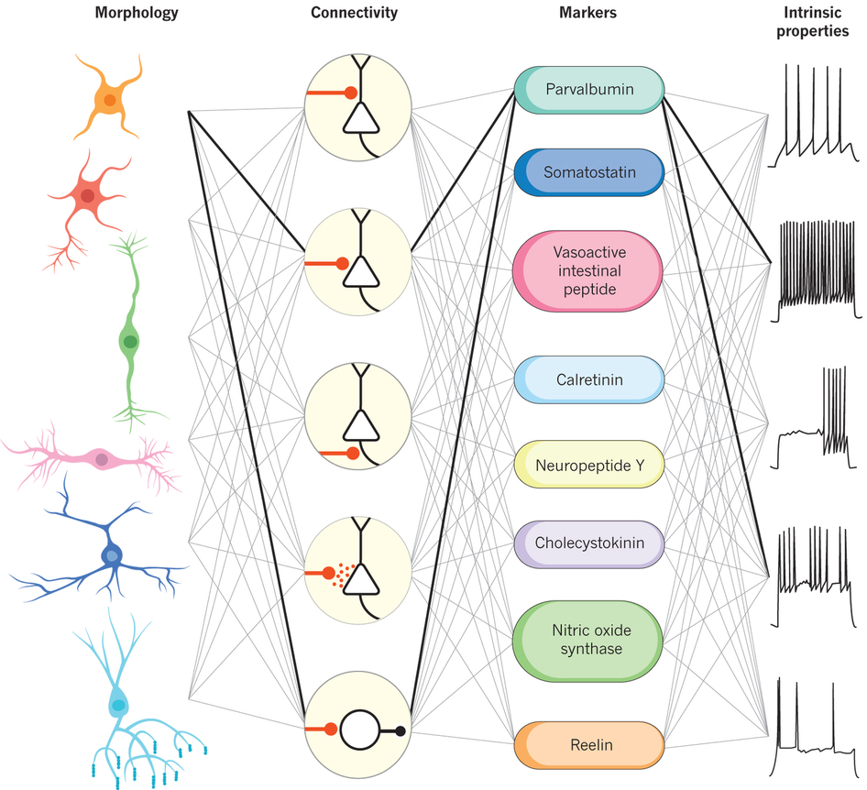
Is there another property that defines them?
Many cortical interneuron types exist
Kepecs & Fishell, 2014
Notes:
As we are well aware, there are many types of cortical interneurons and they are classified by properties such as morphology, connectivity, marker expression, firing, and even participation in some trained behavior, BUT
[press] is there another property that defines them?

Slide 4
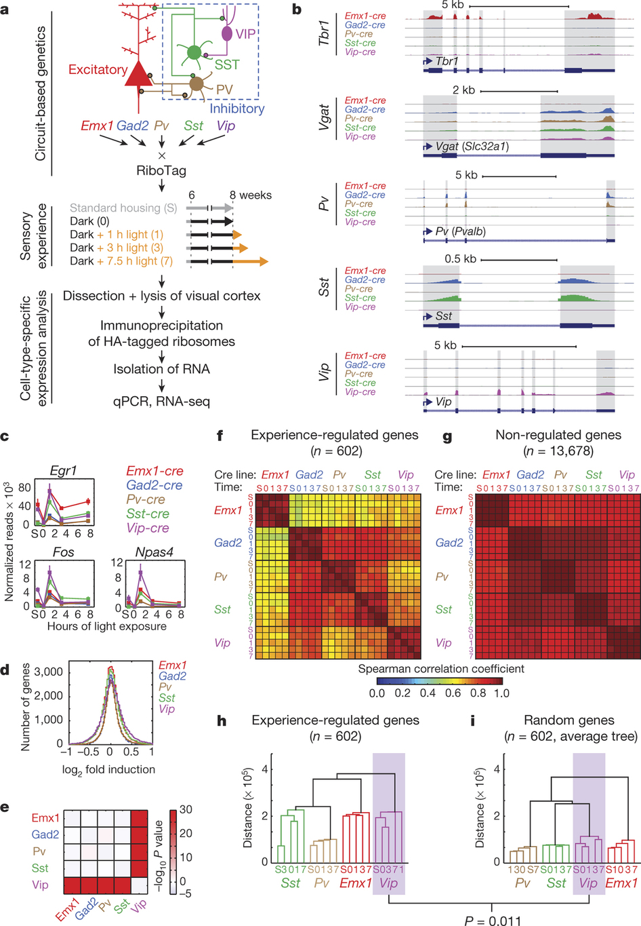
Approach
?
Notes:
So, the authors essentially performed a very big fishing experiment to find out how light exposure affects gene expression in cortical neurons.
They used this general approach to purify ribosome-bound RNA from Cre-expressing neurons specifically in the visual cortex following visual experience manipulations. [press] Now, before we dive into the results, what is ribbotagging?

Slide 5
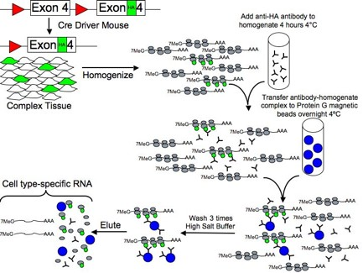
Ribotaggin’
Available via JAX
Assay by seq/pcr
Sanz et al. 2009
Notes:
This cartoon outlines the RiboTag method. First, a mouse which has a modified Ribosomal Protein L22 which is one of the 79 core proteins that constitute the ribosome particle as it is assembled in the nucleolus. A floxed exon 4 allele of the Rpl22 gene has three HA epitopes. Second, a RiboTag mouse is crossed to any available Cre recombinase-expressing mouse line, which results in the deletion of wild-type exon 4 and replacement with the HA-tagged exon 4 only in cells that express Cre recombinase. [press] The cells within the tissue or organ that now express RPL22^{ha}-tagged ribosomes are homogenized, and mixed with HA antibody-coupled magnetic beads to clear the homogenate. After an overnight incubation at 4 °C, [press] the magnetic beads have captured the immunoadsorbed polysomes and are washed with a high salt buffer before extraction of the mRNA transcripts [press]. These transcripts can then be analyzed by qRT-PCR, microarray, or RNA-seq.
The RiboTag mouse has a modified Ribosomal Protein L22 (RPL22), which is one of the 79 core proteins that constitute the ribosome particle as it is assembled in the nucleolus. The final coding exon 4 of the Rpl22 gene is flanked by LoxP recombination sites followed by an identical final exon 4 that has three hemagglutinin (HA) epitope coding sequences inserted before the final STOP codon of the gene. When the RiboTag mouse is crossed to a Cre Driver mouse, the Cre recombinase enzyme is activated in the cell type of interest, resulting in removal of the LoxP-flanked wild type Rpl22 exon 4 and replacement with the HA-tagged Rpl22 exon 4. Following excision of the wild type Rpl22 exon 4, RPL22-HA protein is expressed and incorporated into the ribosome particle.
For the RiboTag procedure, female homozygous RiboTag mice (available from Jackson Laboratories) can be crossed to a male cell type-specific or inducible Cre Driver mouse to obtain experimental offspring that are Cre-Driver+:RiboTag+. Whole brain or micro-dissected/micro-punched brain tissue can be used in the RiboTag IP procedure. The procedure requires approximately 2 days from the point of making the brain homogenate to having cell type-specific RNA ready for analysis by microarray, RNAseq, or qRT-PCR.

Slide 6
What cell-type most influenced?
Notes:
Mice are housed in normal 12L/12D. @ 42 days, some are left in dark only. @ 56 days, some are sacked, and others are exposed to incremental durations of light. I’d be curious to know how the mice responded to sudden light exposure and if that behavioral response itself changed due to light. Did they keep their eyes open for the entire exposure, or did they sleep/hide from light? But I digress…

Slide 7
Fig 1: VIP neurons mount a unique transcriptional response to sensory experience
a_{ij} = a_{ji}
VIP is most diff, but how are reads normalized to compare b/w animals?
As expected
Choice of null dist seems odd to me…
Notes:
b, are examples of the purified transcripts that have been sequenced (exons shaded). As expected, each cre-line expresses high levels of cell type RNA. For example, tbr1 is found in cortical pyram neurons. Vgat is a transporter of gaba and found in the interneurons etc.
[press] c, Also, tracked early-gene expression over light exposure. Line plots show peaks levels of expression in egr1, fos, npas4. All lines have this acute expression then decay to baseline d, Across the different cre-lines, what are the population-level differences in gene expression? Find that VIP has greatest number of visual responsive genes. Could have used a measure of distribution spread (eg variance, range, inter-quartile range) or even confidence intervals (find 95% of AUC fall within this interval). e, heat map which shows pairwise difference in fold-change expression, red being most different, white being not different. VIP is very very different from all other pairwise comparisons.
[press] f,g, Comparison of spearman correlation coefficients (rank/order-based non-linear correlation) of experience-regulated genes vs non-regulated genes in a cell line manner and time point manner. Each creline highly correlates with self in a symmetric matrix. For example, looking down the Gad2 column, it highly correlates with all other iN subtypes. Interestingly, VIP to Emx1 correlation is highest among iN subclasses, but not mentioned in the text or seen in the next analysis. h, i, Another approach is to use Linkage analysis of all experience-regulated genes compared to random genes using the mean expression values of each gene in each sample (i) resampling with replacement based test. Each creline is clustered differently, PV-SST sharing a node, then PV-SST-Emx shares a node which is odd to me… Also the choice of comparator distribution seems odd. Why pull from non-experience regulated genes? Each linkage is pulling from different sets of genes so of course their cluster distances are different… Pull from gad2 responsive genes and ask how similar are the other lines?

Slide 8
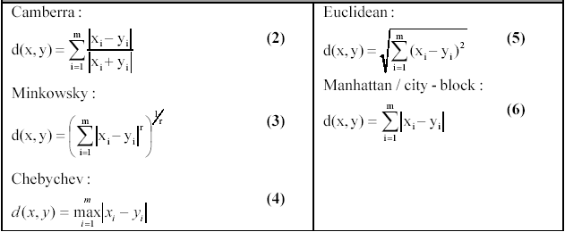
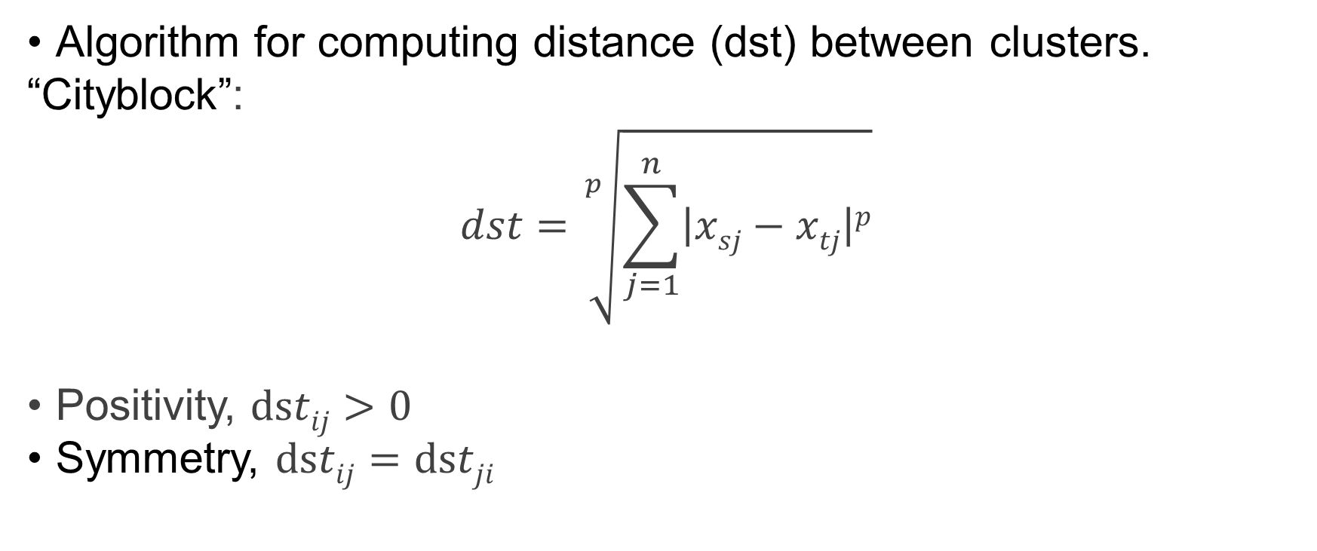
Linkage
Algorithm for computing distance (dst) between clusters.
“Cityblock”:
$$dst=\sqrt[p]{\sum_{j=1}^{n}{\left|xsj−xtj\right|p}}$$
Positivity, $dstij>0$
Symmetry, $dstij=dstji$
Notes:
In a linkage analysis, the authors use the City-block metric defined here. Distance metrics have the properties of positivity and symmetry. And here are some other possible linkage measures

Slide 9
Same input sample: choice of distance metric influences cluster…
Notes:
Importantly, the choice of distance metric can influence the classification of clusters. Here I’m comparing cityblock to Euclidean distance or metric is the "ordinary" (i.e. straight-line) distance between two points in Euclidean space. Older literature refers to the metric as Pythagorean metric.
Using a toy example, (Fisher’s iris flower data set measure of irises petal width, sepal width, sepal length), I plotted a dendrogram of the linkage analysis which is a graphical representation of a matrix of distances. So how to read this? Objects that are joined together in a hierarchical fashion are the most similar (near bottom of plot, least distance), as you ascend the dendrogram, you become more different (or increase in distance, approach top).

Slide 10
What type of visual-responsive genes are induced?
Notes:
So authors have shown that VIP neurons respond to specifically to this light blast and that VIP neurons are the ones to hone in on, but what type of genes are enriched?

Slide 11
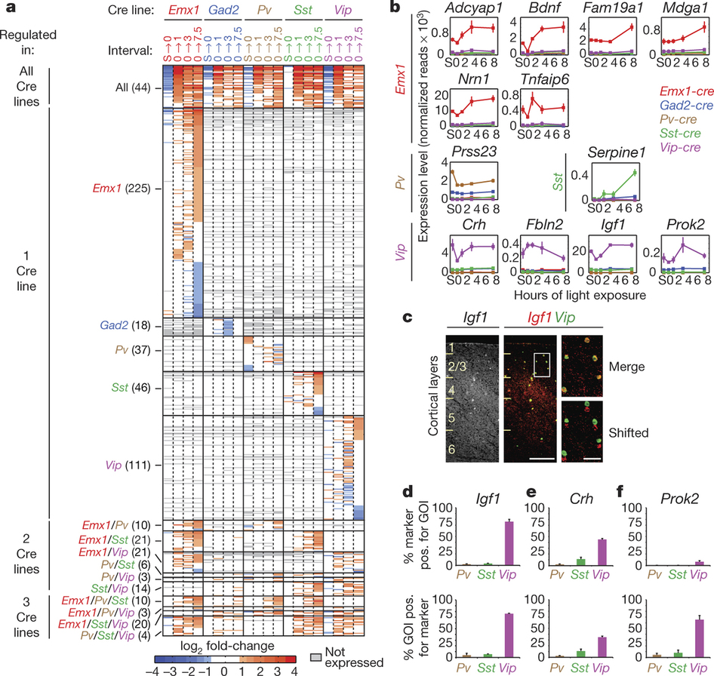
Fig 2: IGF1 is an experience-induced cell-type-specific secreted factor in VIP neurons
GO? → Secretory
Nice!
Validation of ribotaggin’
= 593?
Notes:
Fig2 a, Heat map of all experience-regulated genes across all stimulus intervals. How to read this heatmap? Each pixel represents fold-change expression comparison bw input creline/timepoint at top vs experience regulated genes on left (from Fig1f). Red = increase, white = no change, gray = not expressed, blue = reduced. From this table, 4 sub-sections with an increase the overlap of genes co-regulated by cell type beginning with all lines, then a single creline, then overlapping two, then overlapping 3. I thought this was cool.
[press] b, They asked, now what? Used GO analysis and found secreted factors highly expressed by VIP and pyramidal neurons. Anything interesting there? BDNF! GO seems like black magic to me… Has anyone used this? Seem plausible?
[press] c, Verified their sequencing results from purified Ribotag method with double FISH of Igf1 and Vip directly in mouse visual cortex. d–f, Quantification of FISH staining for Igf1 (d), Crh (e), Prok2 (f) and inhibitory markers in visual cortices of dark-housed/light-exposed mice (n = 3, bars represent s.e.m.). GOI, gene of interest. Everything expected here.

Slide 12
What does IGF1 do in the cortex?
Notes:
Ok, so authors have shown that IGF1 is an experience-induced and cell-type-specific secreted factor in VIP neurons. Now what is IGF1 doing up there and so late in development?

Slide 13
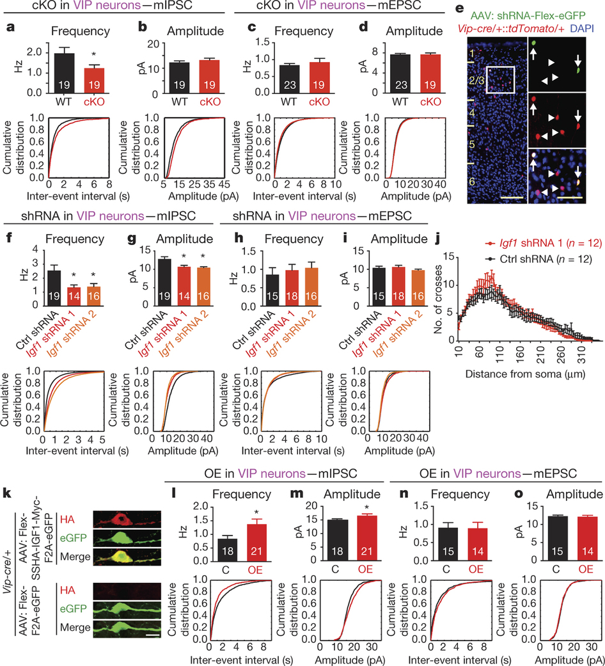
Fig 3: IGF1 promotes inhibitory inputs to VIP neurons in a cell-autonomous manner
IGF1 cKO (vipcre2igf1flox): reduce mIPSC freq
Notes:
Fig3 a–d, To test whether VIP neuron-derived IGF1 affects excitatory and/or inhibitory inputs to VIP neurons, first they used that conditional deletion of Igf1 in all VIP neurons (crossed VIP-cre to IFG1floxed het) so half was much IGF1. Recorded miniature inhibitory and excitatory postsynaptic currents in VIP neurons in acute visual cortex slices; found leads to a significant reduction in mIPSC frequency but not amplitude.
[press] Next, authors asked the cell-autonomous role of VIP interneurons, wanted to find less drastic reduction of IGF1 in VIP neurons. Used virus with floxed shRNA to IGF1 and low infection capacity. e, Image of sparsely infected VIP neurons. Red is the VIP fluorescent marker, green is infection with shRNA. See costain in lower right panel.

Slide 14
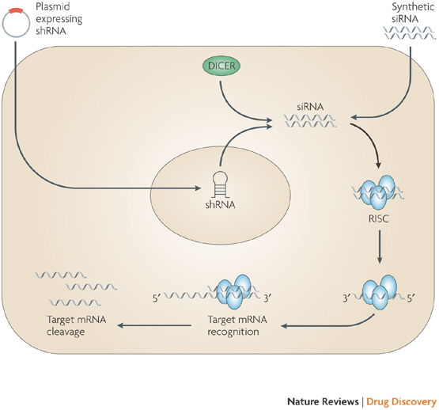
shRNAi
Iorns et al., 2007
Notes:
To get at this question, authors used Short-hairpin RNAs which are processed by the enzyme, DICER, into small-interfering RNA. siRNAs are then incorporated into RISC. A helicase within RISC unwinds duplex siRNA allowing its antisense strand to bind mRNA with a high degree of sequence complementarity. An RNase within RISC degrades the target mRNA by cleavage, which results in silenced gene expression and reduced protein production.

Slide 15
Fig 3: IGF1 promotes inhibitory inputs to VIP neurons in a cell-autonomous manner
Another way to test autonomity? Patch & infect?
IGF1 autonomous? reduce mIPSC freq & amp, see exFig6 for more
Notes:
Now, what did they do with this method? They patched onto VIP neurons (for others see exF6) f–i, saw reduction in mIPSC freq and amplitude, no change to mEPSCs j, no change in dendrite arbors using Sholl analyses of VIP neurons infected with control or Igf1 shRNA.
[press] Asked what’s the effect of overexpression of IGF1 in VIP neurons

Slide 16
Fig 3: IGF1 promotes inhibitory inputs to VIP neurons in a cell-autonomous manner
IGF1 overexpress: increase mIPSC freq & amp, see exFig7 for more
Notes:
What about overexpression of IGF1 in VIP neurons? k, example picture of IGF1 in VIP-neurons. l–o, saw increased mIPSC freq and amp, no change to mEPSCs.

Slide 17
What about function?
Notes:
So authors have shown that IGF1 promotes inhibitory inputs to VIP neurons in a cell-autonomous manner, but what is it doing to the functioning and intact brain?

Slide 18
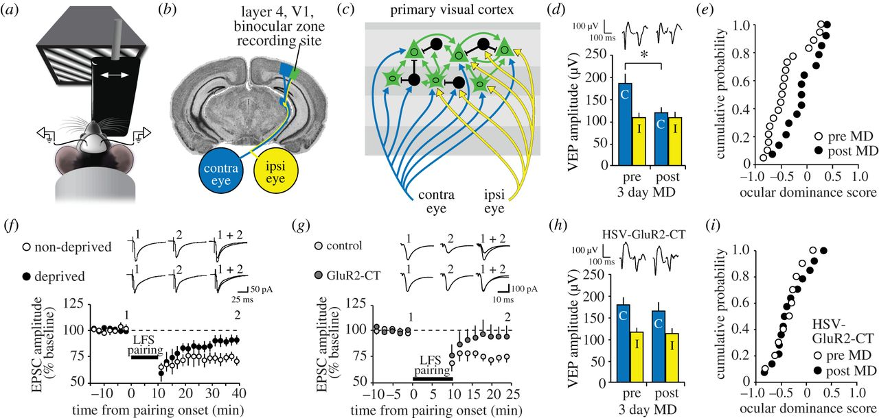
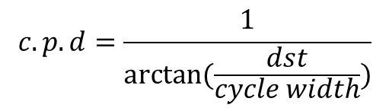
Visual Evoked Potentials (VEP)
Acuity = VEP from deprived eye
reduction of V1 responsiveness to input through the deprived eye
$$c.p.d=\frac{1}{arctan⁡(\frac{dst}{cycle width})}$$
Cooke & Bear 2013
Notes:
Ocular dominance (OD) plasticity results from visual deprivation. Authors used Visual-evoked potentials (VEPs) to study the consequences of MD. How does this work? (a) Head-fixed mouse views sinusoidal grating stimuli while visual-evoked potentials (VEPs) are recorded. An occlude (black panel) is used to restrict visual input to one eye or the other, much like the black spoon we use @ the optometrist. (b) Recordings are targeted in the binocular zone of V1 (green), receiving independent input from the contralateral (blue) and ipsilateral (yellow) eyes.
[press] (c) Layer 4 cells receive converging synaptic input from the two eyes. This input is normally biased in strength towards the eye contralateral to V1 in each hemisphere at a ratio of approximately 2 : 1. The contralateral bias results from ascending inputs from the retinas through the dorsal lateral geniculate nucleus (dLGN) to the cortex in mice. (d) OD plasticity is tested by suturing the contralateral eye for X days to deprive this eye of visual input. Monocular deprivation (MD) results in a significant reduction in the amplitude of VEPs driven by visual input through the contralateral eye. Example waveforms are displayed at the top of the figure.

Slide 19
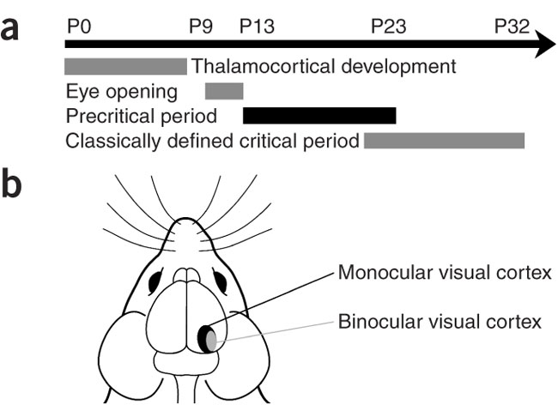
We learned about flies, what about mammals?
Smith et al., 2007
Notes:
(a) Time course of visual system development in the mouse. Eye opening occurs around P10–P13, and the critical period begins around P21–P23. (b) A schematic of the mouse visual pathway. Binocular visual cortex occupies the lateral third of the visual cortex. In adult mice, most cells in the binocular cortex receive input from both eyes. MD reliably causes OD plasticity in all mammals with binocular vision, its shown as a reduction of V1 responsiveness to input through the deprived eye and enhancement of responsiveness to input through the non-deprived eye

Slide 20
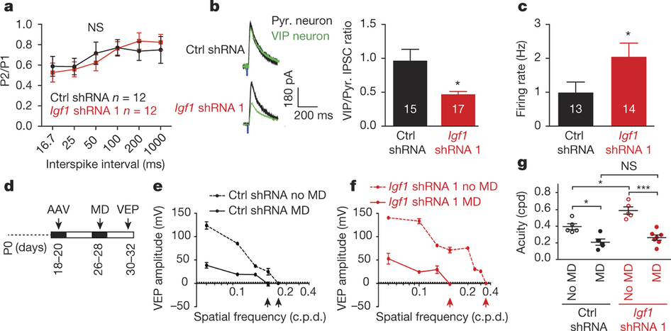
Fig 4: VIP-neuron-derived IGF1 regulates VIP neuron function and regulates visual acuity in an experience-dependent manner
No change short term plasticity
Evoked: Reduced amp rel 2 pyr, increased firing rate
Notes:
Fig 4 a, stimmed below cortical layers (presume to get thalamo-cortical afferents). no change in Paired-pulse recordings from VIP neurons with Igf1 shRNA indicating presynaptic release normal. b, Next looked at evoked inhibitory potentials (held at 0 mV holding potential). Green trace in IGF1 knockdown is reduced compared to neighbouring pyramidal neurons (Pyr., black traces). Quantified and saw lower IPSC ratio with IGF knockdown and c, Saw increase in firing rate of VIP neurons infected with Igf1 knockdown. Suggests IGF1 from VIP is required for the inhibitory response.

Slide 21
Fig 4: VIP-neuron-derived IGF1 regulates VIP neuron function and regulates visual acuity in an experience-dependent manner
Huh?
Knckd = better?
During crit period
visual acuity: response to increase in spatial frequency of the gratings, higher = better. See exF8 for evoked trans
Notes:
[press] On to the deprivation experiment d, Timeline for this experiment. Authors exploit experience dependent visual development. During early vis development, Inject AAV of shrnas, then deprive one eye, allow development to occur either binocularly or monocularly, finally record VEPs. e,f, plot VEP amplitude as a function of spatial frequency (cycles per degree (c.p.d.)) in the contralateral visual cortex of mice. Dashed lines (black,red) is no MD, both have VEP responses to faster alternations. Solid lines (black,red) have reduced acuity due MD. g, saw greater visual acuity when IGF1 is knocked down… (what does that mean?) Should have tried the IGF1 overexpression with MD?

Slide 22
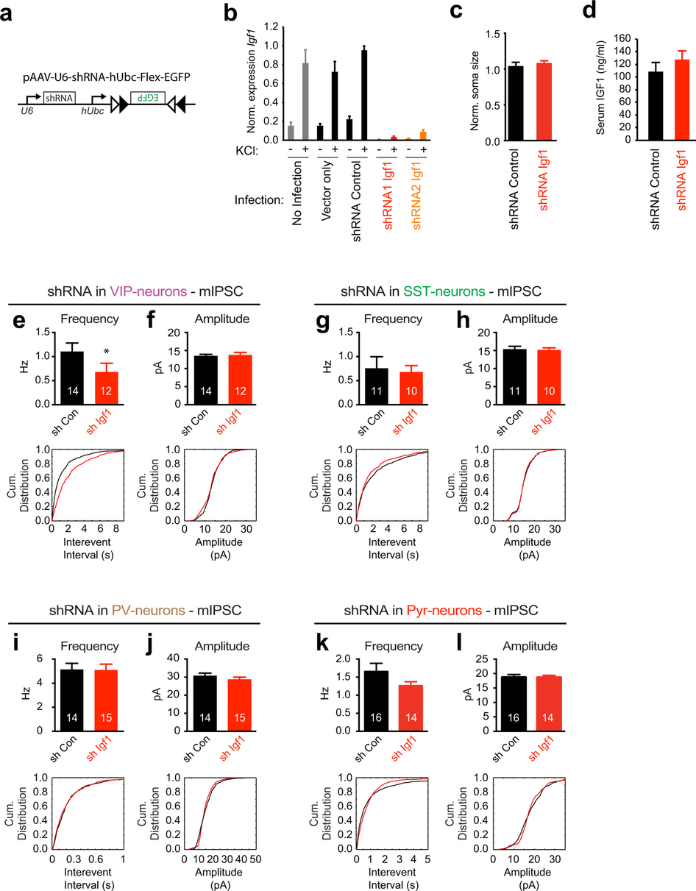
Extended Data Figure 6: Igf1 knockdown in VIP neurons affects inhibitory inputs onto VIP neurons but not onto neighboring neurons.
Notes:
ExFig 6a, generated short hairpin RNA (shRNA) constructs against Igf1. b, validated silencing of Igf1 expression with shRNA constructs. c, did not see cell body differences. d, No diff in serum levels of IGF1. e–l, tested specificity of IGF1 silencing on other cell types. Only saw reduced mIPSC freq in VIP neurons.

Slide 23
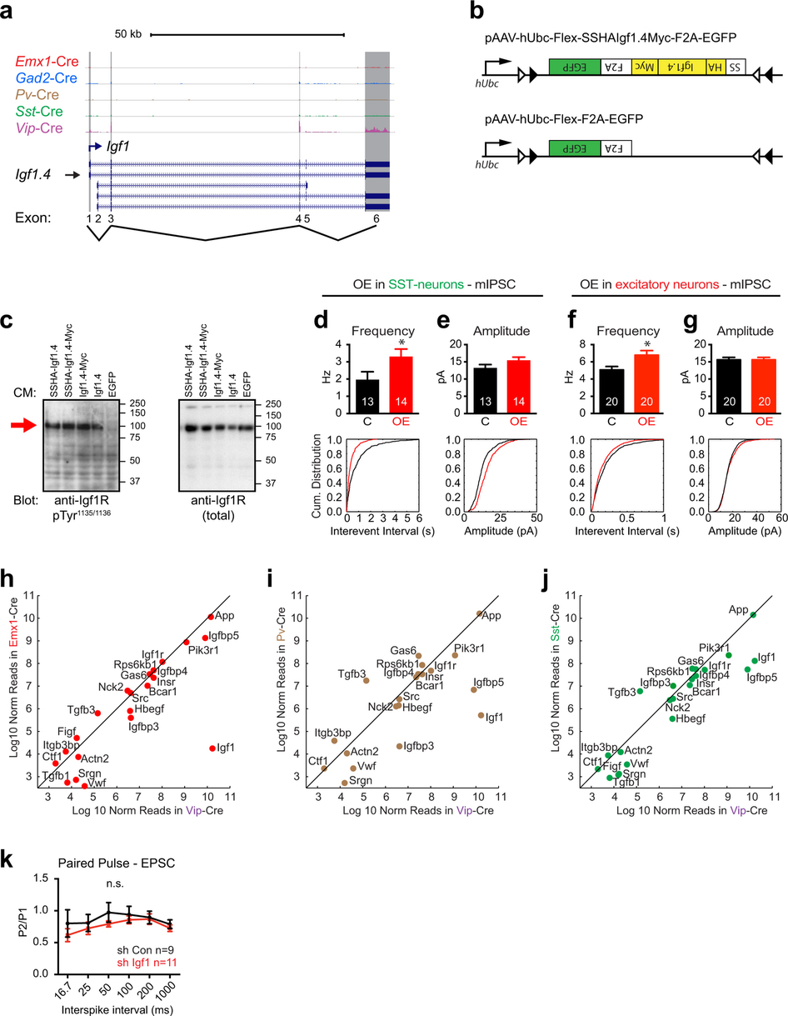
Extended Data Figure 7: Effects of IGF1 overexpression in excitatory and SST-positive neurons.
Not sure how to read this
SST/Pyram as presynaptic targets influenced?
Igf1 away from unity
Notes:
ExFig 7 More data to show Igf1.4 as the major Igf1 isoform expressed in VIP neurons. a, RNA-seq reads (what should I be looking at?). b, AAV constructs for the Cre-dependent expression of HA-/Myc-tagged IGF1 (Igf1.4). c, Western blot analysis shows the band of the IGF1 receptor. d, e, f, g, Increase freq but not amplitude in SST and pyram neurons. h–j, Scatter plots of IGF1-interacting proteins showing the log₁₀ normalized mean expression values in Vip-cre neurons versus each of the other Cre lines (Emx1 (h), Pv (i), Sst (j)). k, Quantification of EPSC paired-pulse recordings from VIP neurons infected with control shRNA- (blackn = 9) or Igf1 shRNA- (red n = 11) expressing AAVs. The ratio of the second EPSC amplitude divided by the first EPSC amplitude is plotted against inter-stimulus interval (P = 0.1, two-way ANOVA).

Slide 24
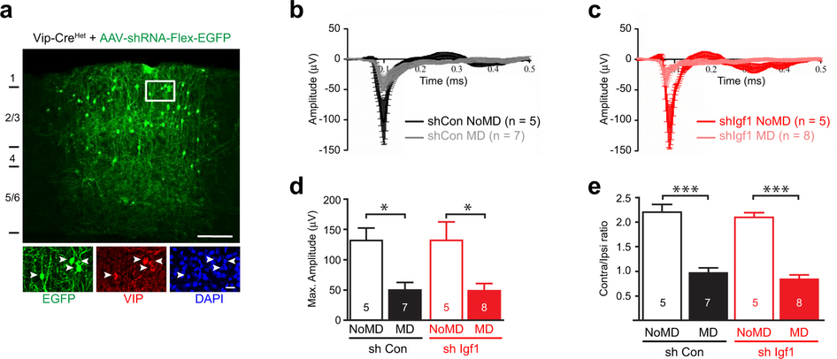
Extended Data Figure 8 VIP neuron-derived IGF1 does not disrupt ocular dominance plasticity.
VEP = neg peak in 50-150ms window
control
silenced
Notes:
ExFig 8 a, Example infection of VIP neurons by AAV-shRNA. b, c, Averaged VEP traces recorded in the visual cortices of mice that were injected with AAVs expressing control shRNA (black/grey) or shRNA against Igf1(red/pink) shRNA and that were (grey, pink) or were not (black, red) subjected to monocular deprivation in the eye contralateral to the recording site (MD versus NoMD, respectively). d, MD reduced VEP amplitude in both cases. e, Normal ocular dominance plasticity as MD shifts to the ispilateral eye in both groups (ratio of contra to ipsi is lower). Indicating its not the ocular dominance that’s different, but the visual acuity.

Slide 25
Conclusion
By varying exposure to light in the young adult, the following properties are altered:
Acute gene expression
“class” of genes (secretory)
Inhibitory inputs to VIPn increase
Visual acuity regulated by IGF1 from VIPn
IGF-1 was one candidate shown to act by VIPn on VIPn
Adds to the function of a IGF1, a secretory protein
i.e. not just neurogenesis, metabolism, development
Notes:
Ok, so this was kind of a beast of a paper to go through, but truly amazing what the authors did as a group. Authors identify an experience-dependent gene expression program in vasoactive intestinal polypeptide (VIP)-expressing interneurons of the visual cortex that is distinct from those expression patterns observed in other neuronal subtypes. IGF1 (insulin-like growth factor 1) was identified as an activity-dependent gene that functions cell autonomously to increase inhibitory input onto VIP neurons, affecting downstream excitation–inhibition balance within circuits that regulate visual acuity

